Slide 1
ORGANS OF IMMUNE SYSTEM PRIMARY AND SECONDARY LYMPHOID ORGANS
Dr G Chinnadurai
Assistant Professor
Periyar Government Arts College
Cuddalore – 607001.

Slide 2
LYMPHOID ORGANS
Primary Lymphoid
Bone marrow
Thymus
Secondary Lymphoid Lymph nodes Spleen
MALT

Slide 3
PRIMARY LYMPHOID ORGANS
Lymphoid stem cells undergo proliferation
differentiation and maturation into T and B cells.
Acquire antigen specific reception.
After maturation T and B cells migrate to secondary lymphoid organs.
In mammals - Thymus, Bone marrow
In Birds -Thymus, Bursa of Fabricius Major sites of Lymphopoiesis
T cell - Thymus, B cell - Bone marrow Control Peripheral Lymphoid Organs.

Slide 4
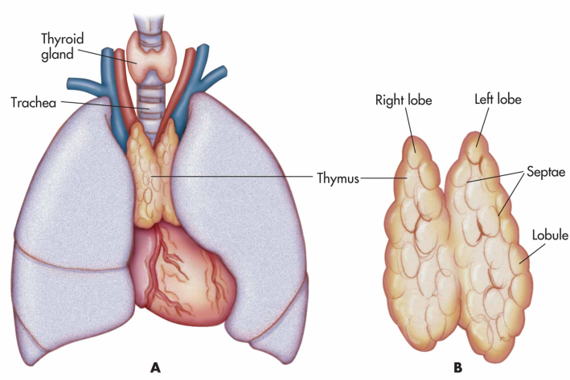
THYMUS
Bilobed organ.
Situated above the heart.
Each lobe enclosed by capsule
Each lobule separated by connective tissue trabeculae.
Outer Cortex – Inner Medulla –
Immature T cells in called – Thymocytes
Thymic epithetical cells in outer cortex called cells.
called
Nurse
Hassall's corpuscles – contain degenerating epithelial cells.

Slide 5
Site of T cell development and maturation.
Development of cell mediated immunity.
Thymic epithelial cells produce hormones and thymopoietin.
T cell receptor generated. Recognizing antigen MHC complex. T cells protect body from infection.
thymosin

Slide 6
Removal of thymus from newborn mice.
Decrease in circulating lymphocytes.
Absence of cell mediated immunity.
Increase in infectious disease.
Congential birth defect in humans
[ Diveorge’s Syndrome ]
Mice – mude mice
Aging – decline in thymic function Maximal size at puberty.

Slide 7
BONE MARROW
Site of blood cell formation. B cell origin and mature
E.g. Humans and Mice
Fat cells, bony tissue, dendritic cells
Stomatal cells interact with B cells Secrete cytokines.
Selection process occur.
It is not the site of B cell development in all species.

Slide 8
BURSA OF FABRICIUS
Gut associated lymphoid organs. [ Birds ]
Lymph epithelial tissue. Hindgut of chicken.
Multiply and differentiate into B lymphocytes. Immuno globulins synthesis.
Described by Fabricus in 1621.
Humoral immunity in birds.
Absent in mammals ( primates, rodents ).

Slide 9
SECONDARY LYMPHOID ORGANS
Organs in which antibodies are formed.
Antigen trapping and lymph filtration mechanism.
Receive immuno competenal cells (primary lymphoid
organ for making them and active).
Spleen Lymph nodes
Mucosa associated lymphoid tissue.

Slide 10
LYMPH NODES
Solid encapsulated bean shaped structure. Seen in Armpits, Mesenteries.
Network packed with lymphocytes, macrophages, dendritic cells.
Three concentric regions :- Cortex , Para cortex, Medulla
CORTEX :-
Outer most layer
Contains lymphocytes, macrophage, follicular dendritic cells arranged in primary follicle
Lymphoid tissues organized into structures - lymphoid follicle.
Lymphoid follicle activated by antigen – primary follicle [ Follicular Dendritic Cell, Resting B Cell ]

Slide 11
Primary follicle develop into secondary follicle.
In children with B cell deficiency cortex lack primary follicles and germinal centers.
PARACORTEX :-
[ T lymphocytes, interdigiting dendritic cells ]. Thymus dependent area – Para cortex Thymus independent area – Cortex
Class II MHC present.
MEDULLA :-
Inner most layer

Slide 13
Antigen reaches regional node (lymph)
It is trapped
Class II MHC molecules – Antigen
dendritic cells)
( interdigitating
Resulting activation of TH cells.
Activation of B cells.
Initial activation of B cells take place within Para cortex. B cells differentiate into plasma cell.
Secreting IgG.
Secondary follicle develop.
( Follicular dendritic cell, B cell, TH cell )

Slide 14
SPLEEN
Bean shaped organ.
Left side of abdominal cavity.
Specializes in filtering blood and trapping blood borne antigens.
Blood borne antigens, lymphocytes into spleen through
splenic artery.
Spleen surrounded by capsule.
Two types of compartment red and white pulp.
Red pulp – network of sinusoids macrophage, RBC,
lymphocyte.
Old and defective RBC destroy.
White pulp - consist of lymphoid tissue, T and B lymphocytes.
White pulps surrounds branches of splenic artery forming Per arteriolar Lymphoid Sheath (PALS).
Marginal zone located peripheral to PALS [ Lymphocytes and Macrophages].

Slide 16
Blood borne antigen and lymphocytes
(Splenic artery)
Spleen
Marginal Zone [trapped by interdigiting
dendritic cells]
PALS
Initial activation of Band T cell in – PALS Dendritic cell capture antigen
Combined with MHC molecule and TH cells Activates B cells
Primary follicles in marginal zone Secondary follicles [ germinal centre] Rapidly dividing B cells
Plasma cells - antibody production

Slide 17
In children, splenectomy – increases bacterial sepsis,
pneumonia, influence.
Splenectomy in adult – increase in blood borne bacterial infection.

Slide 18
MUCOSA ASSOSCIATED LYMPHOID TISSUE
Lymphoid tissue in mucosal epithelial surface –
Antibody producing plasma cells.
MALT
Nasal associated lymphoid tissue – back of nose, palate, base of tongue, tonsils
Handling airborne microbes
Tonsils defend against antigen entire through nasal
and oral epithelial route
Respiratory, Uriogential, Gastrointestinal tract The endocytose antigen from lumen
Mucous membrane – effective barrier Non specific immunity

Slide 19
Peyer’s patches found in ileum.
Round patches of lymphatic nodes
Develop into secondary follicle in germinal center Antigen transport by specialized M cells.
Pockets of M cells – B cells, T cells, Macrophages M cells locate in inductive sites

Slide 20
Antigen transported across mucous membrane by M
cells
Activate B cells in follicle Differentiate into plasma cells Secrete 1gA class of antibodies Transported across epithelial cells Secretary 1gA into lumen
Interact with antigen

